Slide 1
Excel Simulator Tips & Tricks
2021 SAWTOOTH SOFTWARE CONFERENCE

Slide 2
Additional Files
https://github.com/kpfairchild/ExcelSimulator

Slide 3
Topics we’ll cover
Why Excel?
Elements of an Excel Simulator
Essential Excel Tricks
Array/Spill Formulas
Named Ranges
Other essentials
Essential Simulator Calculations
Segmentation and Weighting
Style Considerations
Putting it all Together

Slide 4
Why Excel?
We have lots of simulator options:
Lighthouse - Most powerful!
sawtoothsimulator.com - Most online!
Lighthouse Excel export - Easy option, less flexible, not client ready
Custom Excel Simulator – Fully customizable, easy to give to clients

Slide 5
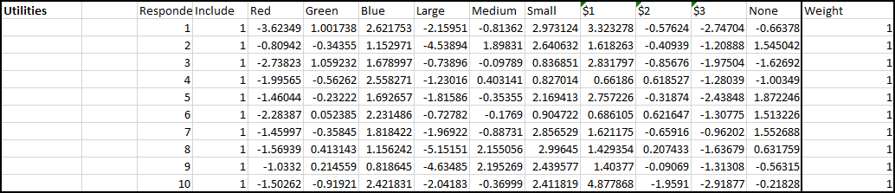
Elements of an Excel Simulator
Raw Utilities

Slide 6
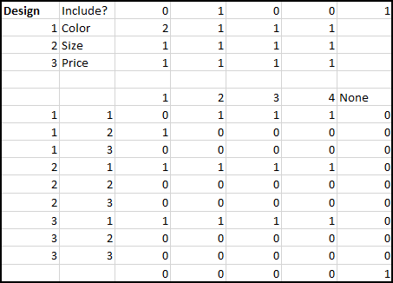

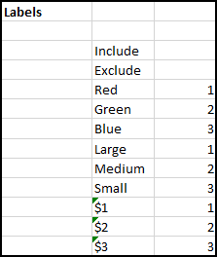
Elements of an Excel Simulator
Calculations/other hidden stuff

Slide 7
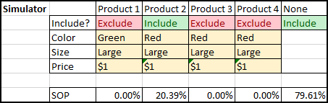
Elements of an Excel Simulator
Client facing configurator and share of preference display

Slide 8
Essential Excel Tricks - Array Formulas
Runs calculations on whole arrays of values at the same time
Can output to multiple cells
Can reduce the total amount of cells that need to store intermediate calculation steps (brevity/clarity tradeoff!!)
How to:
When editing a cell, press ‘Control+Shift+Enter’ (CSE) instead of ‘Enter’. (Or don’t will spill formulas)
F9 is your best friend to evaluate intermediate steps for difficult computations
Notes:
https://support.office.com/en-us/article/guidelines-and-examples-of-array-formulas-7d94a64e-3ff3-4686-9372-ecfd5caa57c7

Slide 9
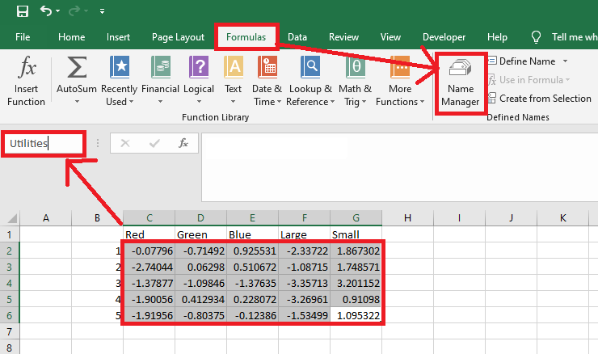
Essential Excel Tricks - Named Ranges

Slide 10
Essential Excel Tricks - Other common formulas
Finding stuff
VLOOKUP – Find a value, return another value (New XLOOKUP)
MATCH – Find a value, tell me where you found it
Indicator logic (converting TRUE/FALSE to 1/0)
OFFSET – Give me a cell near a cell, offset by some amount
ROW/COLUMN – What row am I on?
INDEX – Give me subset of another selection

Slide 11
Calculation Flow Chart
Configurator
Utilities
Design
Filters
Total Utilities
Share of Preference
Weights
Average Shares

Slide 12
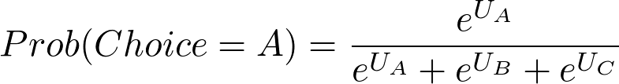
Essential Calculations
Total Utility Calculation:
Formula:
Excel (standard): =sum(a1:e1)
Excel (array): =MMULT(Utilities,Design) or SUMPRODUCT(Utilities, Design)
Share of Preference:
Formula:
Excel (standard): =exp(a1)/(exp(a1)+exp(b1)+exp(c1)
Excel (array): =exp(a1:c1)/sum(exp(a1:c1))

Slide 13
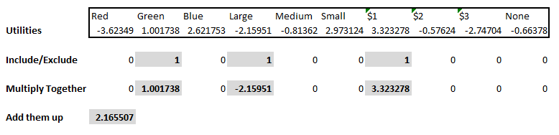
Essential Calculations - Total Utility

Slide 14
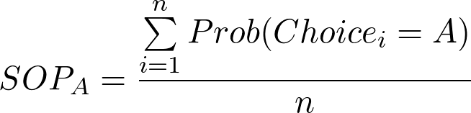
Essential Calculations – Average Share of Preference
Excel (standard): sum(A:A)/count(A:A)
Notes:
Average share of preference is just the average over each respondent’s share of preference.

Slide 15
Segmentation and Weighting
Segmentation – Filtering of respondents by known subgroups
Weighting – Changing respondent’s relative contribution toward group average
Use weighting when your actual population is different in a known way from your sampled population.

Slide 16
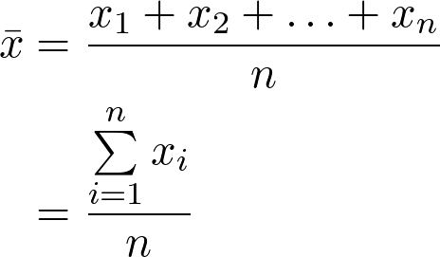
Segmentation and Weighting – Review Averages
Regular Average:

Slide 17
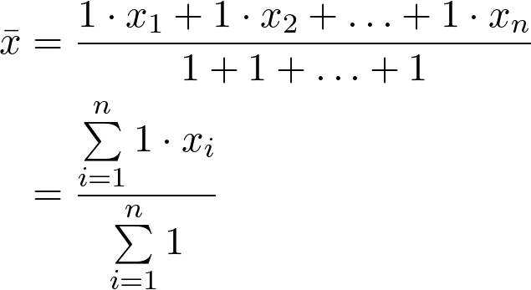
Segmentation and Weighting – Review Averages
Regular Average with weights shown:

Slide 18
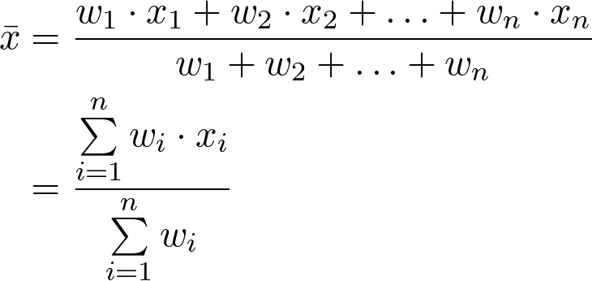
Segmentation and Weighting – Review Averages
Weighted Average with weights shown:
Excel(array + named ranges): =sum(weights*values)/sum(weights)

Slide 19
Segmentation and Weighting – Segmentation
For building our simulators, we can just treat segmentation as a matter of setting our weights equal to zero when the segment should be excluded.
i.e. filtering and setting weight to zero are equivalent

Slide 20
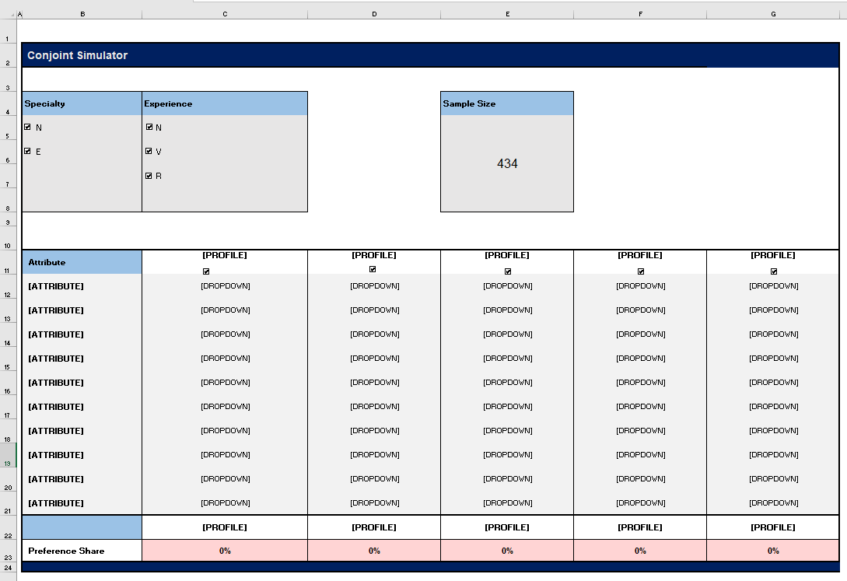
Style Considerations
Keep it simple
Get it working before styling

Slide 21
Let’s look at an example!

Slide 22
QUESTIONS?
kenneth@sawtoothsoftware.com
www.sawtoothsoftware.com
+1 801 477 4700

